Slide 1
TOUR AND TRAVELS

Slide 2
Introduction
The Tours and Travel Management System is a web-based application. The main purpose of “Tours and travels management system” is to provide a convenient way for a customer to book hotels, flight, train and bus for tour purposes. The objective of this project is to develop a system that automates the processes and activities of a travel agency. In this project, we will make an easier task of searching places and for booking train, flight or bus.
In the present system a customer has to approach various agencies to find details of places and to book tickets. This often requires a lot of time and effort. We provide approach skills to critically examine how a tourist visits and its ability to operate in an appropriate way when dealing with the consequences of tourism, locally, regionally, and nationally including visitor security and ecological influences.
It is tedious for a customer to plan a particular journey and have it executed properly. The project ‘Tours and Travels Management System’ is developed to replace the currently existing system, which helps in keeping records of the customer details of destination as well as payment received.
Tourism can be considered as most favorite pass time when people get free time. Several travel organizations are available on the web.
The people or the tourist select their own Travel Package according to their personal interest. The travel companies concentrate on the interest associated with tourist making sure to increase their particular market value and supply enormous package deals. So that they can make their Travel Package more effective.
Now-a-days Recommender system is becoming very famous and people are getting attracted to it, as it is helping them to choose the best package in a short time.
Recommender systems are categorized into

Slide 3
Objective
This application is developed to provide best travelling services to the customers and travel agents.
We have developed tours and travel management system to provide a search platform where a tourist can find their tour places according to their choices.
This system also helps to promote responsible and interesting tourism so that people can enjoy their holidays at their favorable places.
This system also helps to develop tourism with different cultures so that they enrich the tourism experience and build pride.
We develop this system to create and promote forms of tourism that provide healthy interaction opportunities for tourists and locals and increase better understanding of different cultures, customs, lifestyles, traditional knowledge and believe.
This system also provides better way to connect with various events. This system also gives tours related information like which places are tourist attractions, cities, and provinces.
Tourist can also get the Map and navigation system and temperature and weather information.
Tourist can also book tours through our tours and travels management system. This system also keeps a history of visited places of its users.

Slide 4
Technical Specifications
Hardware Requirements:
Processer: Intel Pentium and Above Version
Speed: 1.60 GHz
Hard Disk: 300 GB and Above
Key Board: Standard
RAM:4GB
Software Requirements:
Operating System: Window 7
Data Base: My SQL
Tools: HTML, CSS, JavaScript, jQuery, Python 3.7

Slide 5
Data Flow Diagram
User Registration
Insertion
Data base
User Login
Get user detail
User panel
Insertion
Get package detail
Package manager
Package Booking

Slide 6
E-R MODEL FOR QUERY SUBMISSION
Reg_Id
Customer_Id
feedback
Customer_Id
initial_deposit
Package_Id
Package_Id
Registration
Feedback
Amount
Customer_Id
Remark
Date
Rating
Date
Package_Id
No_of_person
feedback_Id
TXN
Address
Email_id
Remark
Date
Customer_Id
password
Txn_Id
Name
Customer
Description
Customer_Id
Age
City
Package_Id
Contact_no
Tour_package
Discount
Cost

Slide 7
SITEMAP
Home
Package details
Sign UP
Login
Feedback
Package registration
Registration Status
About Us
Contact Us

Slide 8
HTML
HTML is the standard markup language for creating Web pages.
HTML describes the structure of Web pages using markup
HTML elements are the building blocks of HTML pages
HTML elements are represented by tags
HTML tags label pieces of content such as "heading", "paragraph", "table", and so on
Browsers do not display the HTML tags, but use them to render the content of the page

Slide 9
JAVASCRIPT
JavaScript was designed to add interactivity to HTML pages
JavaScript is a scripting language
A scripting language is a lightweight programming language
JavaScript is usually embedded directly into HTML pages
JavaScript is an interpreted language (means that scripts execute without preliminary compilation)
Everyone can use JavaScript without purchasing a license

Slide 10
PYTHON
Python is a high-level, interpreted, interactive and object-oriented scripting language. Python is designed to be highly readable. It uses English keywords frequently where as other languages use punctuation, and it has fewer syntactical constructions than other languages.
Python is Interpreted − Python is processed at runtime by the interpreter. You do not need to compile your program before executing it. This is similar to PERL and PHP.
Python is Interactive − You can actually sit at a Python prompt and interact with the interpreter directly to write your programs.
Python is Object-Oriented − Python supports Object-Oriented style or technique of programming that encapsulates code within objects.
Python is a Beginner's Language − Python is a great language for the beginner-level programmers and supports the development of a wide range of applications from simple text processing to WWW browsers to games.

Slide 11
Database Design
create table Customer (Customer_Id int primary key, Name varchar (20), Age varchar (3), Contact_no varchar (50), Address varchar (50), Email_id varchar (30), City varchar (20), password varchar (20))
create table Tour_package (Package_Id int primary key,Package_Name varchar (20),Description varchar (50),Cost int,Discount int)
create table Registration (Reg_Id int primary key, Customer_Id int foreign key references customer(customer_id),Package_Id int foreign key references Tour_package(package_Id),date,No_of_personint,initial_depositint,remark varchar (50))
create table Txn (Txn_Id int primary key,Customer_Id int foreign key references customer(customer_id),Package_Id int foreign key references Tour_package(package_Id),Amount int,date,remark varchar (500))
create table feedback (feedback_Id int primary key, Customer_Id int foreign key references customer(customer_id), Package_Id int foreign key references Tour_package(package_Id), feedback varchar (500), date, Rating int,)

Slide 12
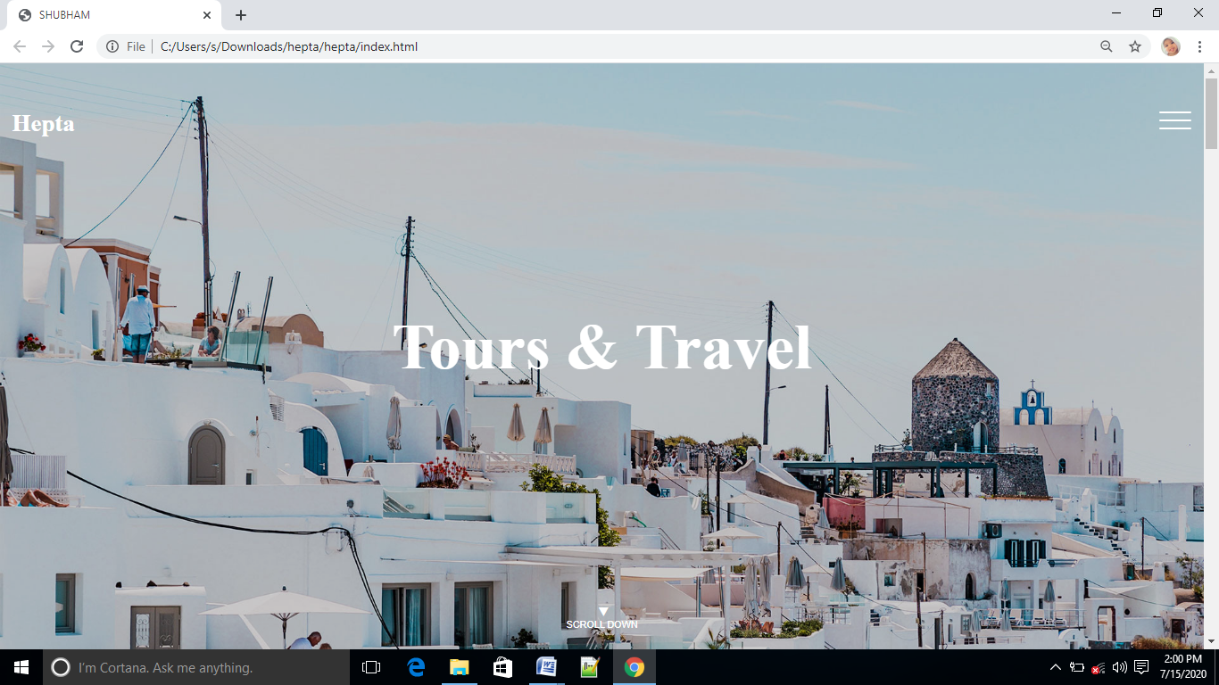
Home page

Slide 13
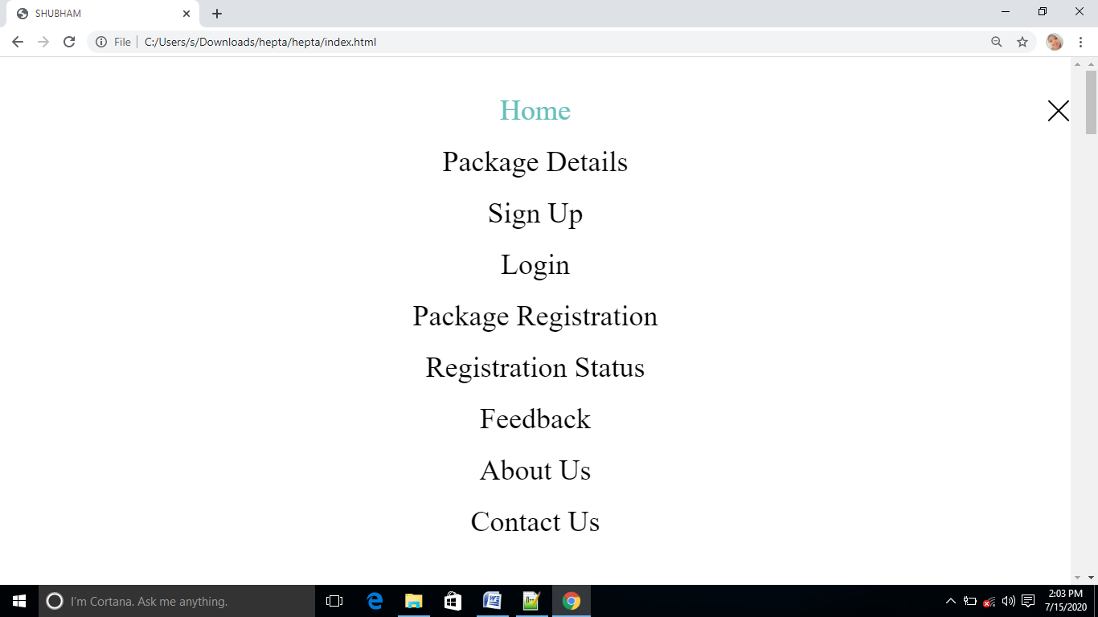
Menu

Slide 14
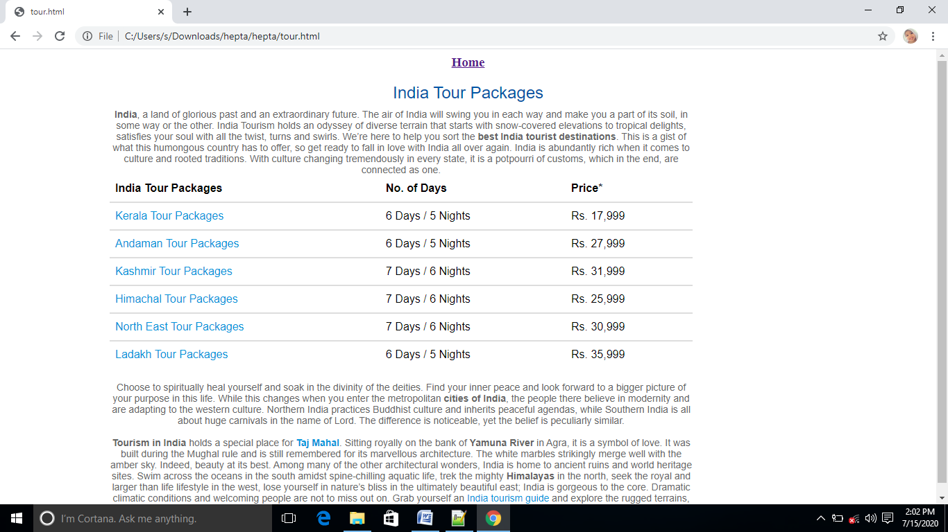
Tour Package

Slide 15
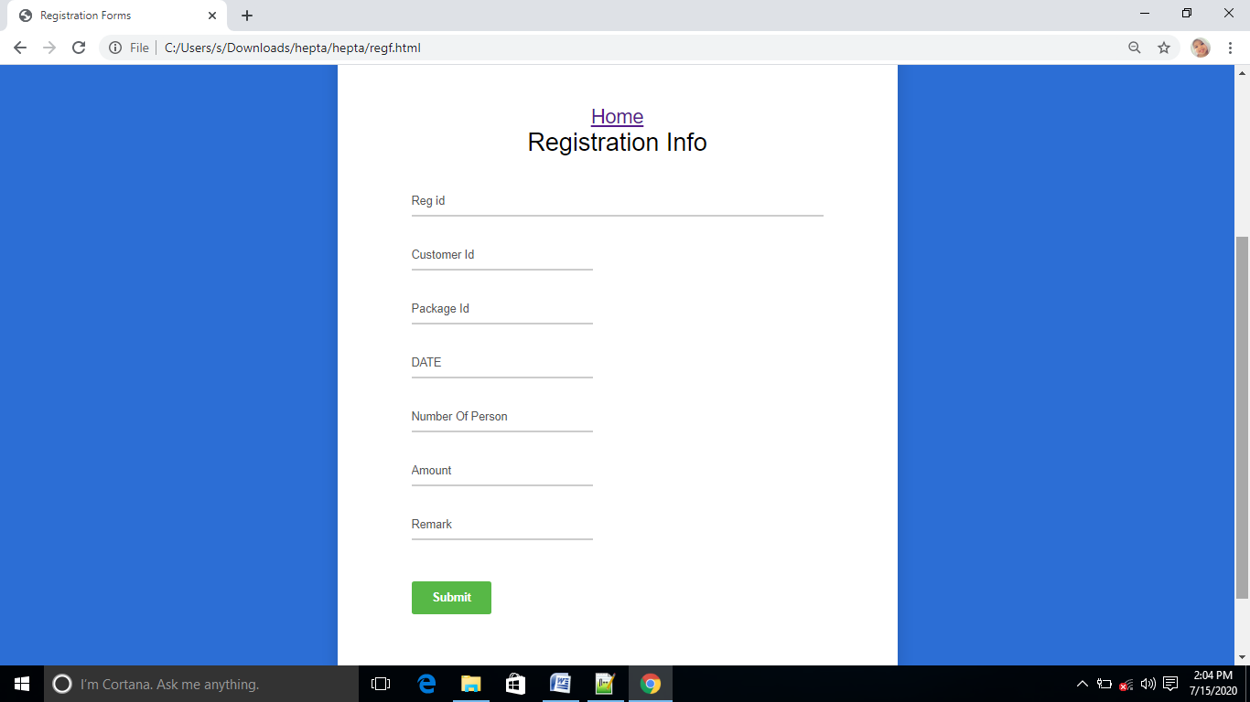
Registration

Slide 16
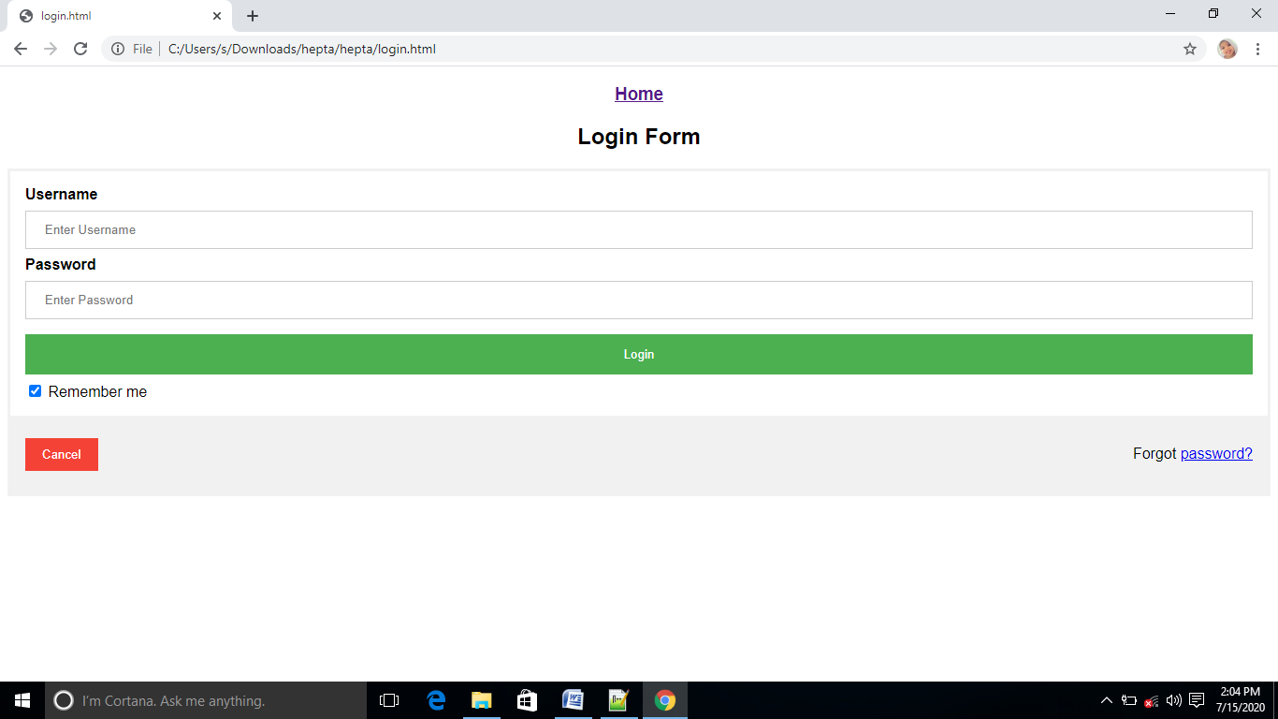
Login Page

Slide 17
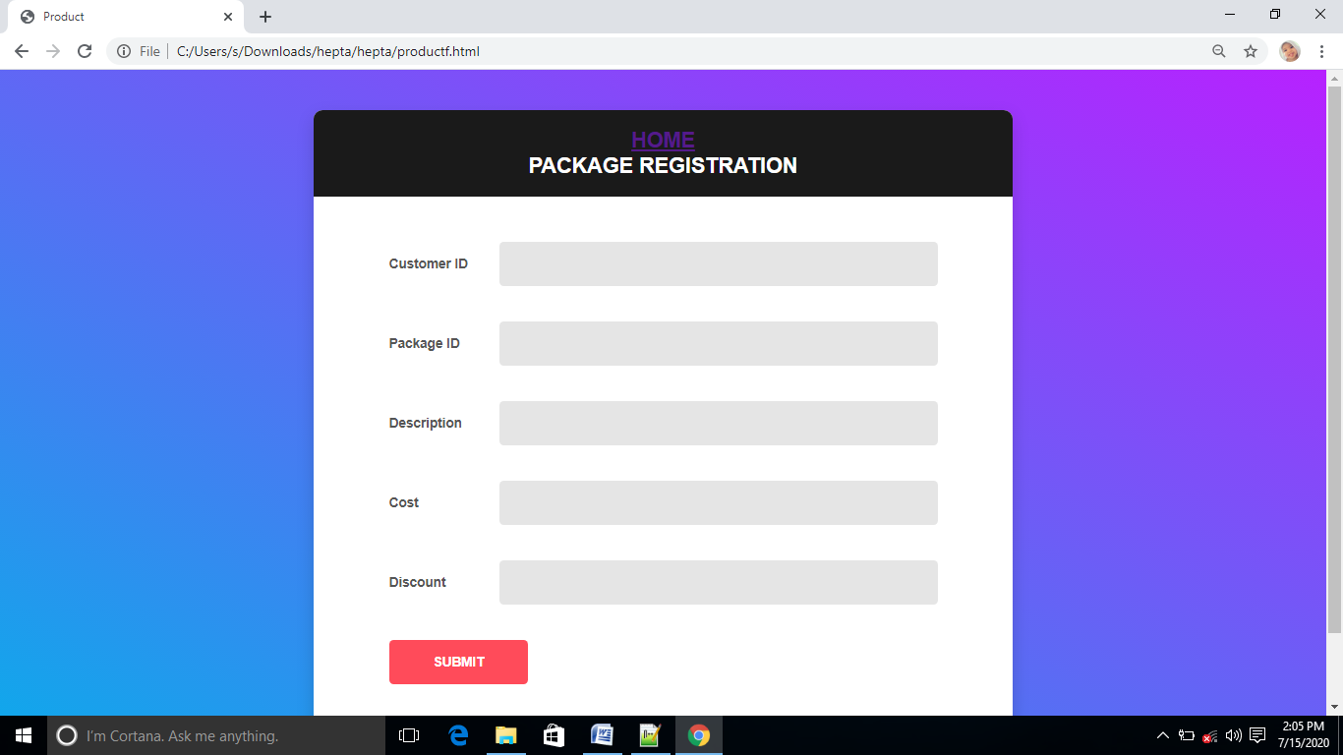
Package Registration

Slide 18
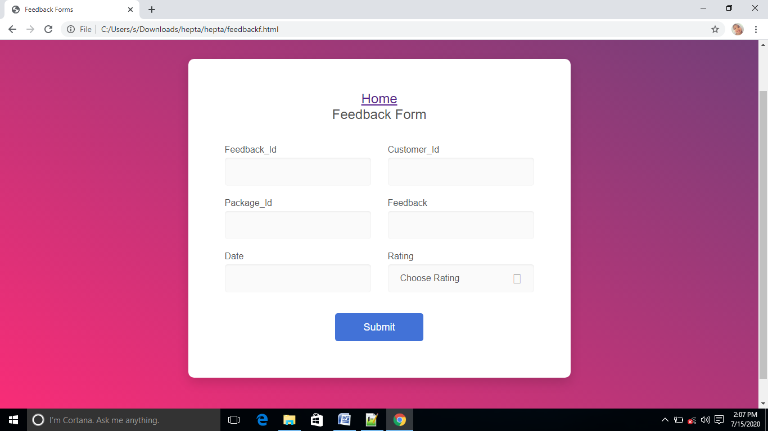
Feedback form

Slide 19
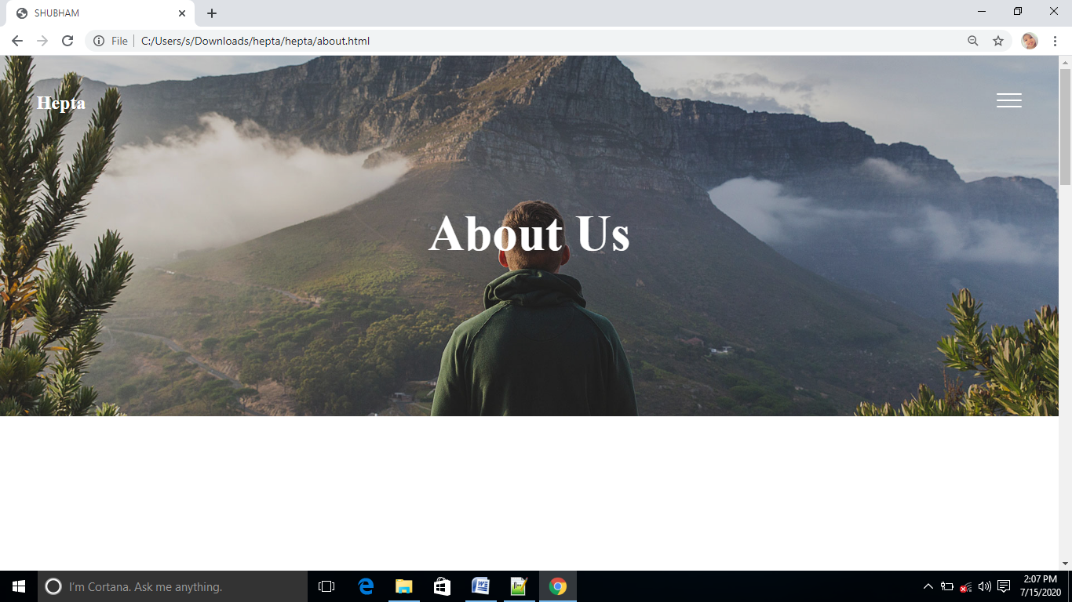
About us

Slide 20
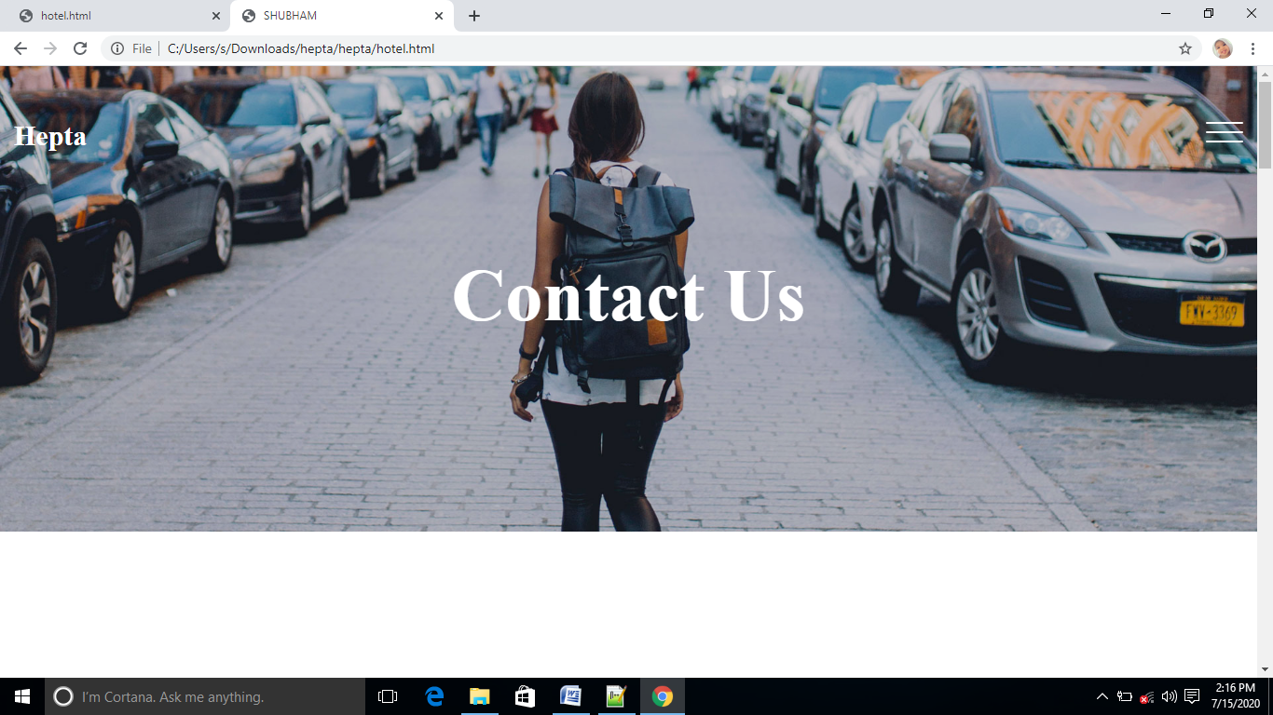
Contact us

Slide 21
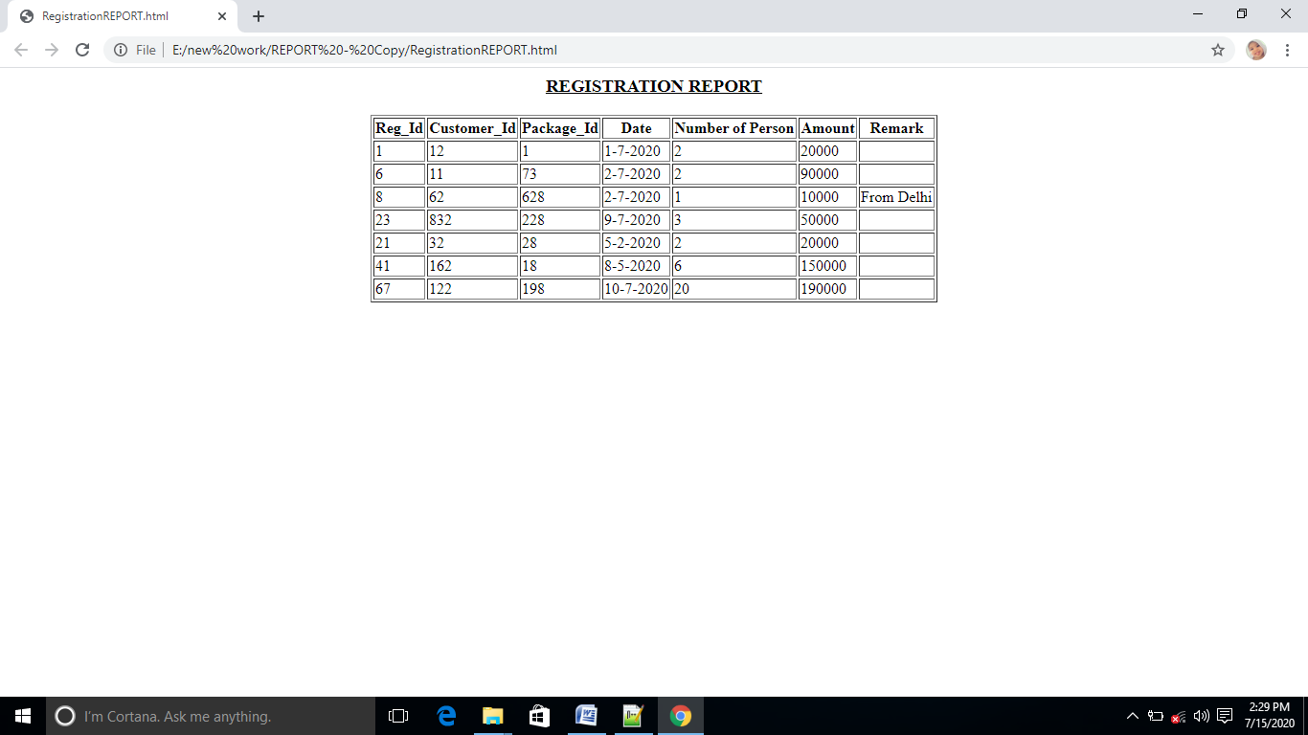
REGISTRATION REPORT

Slide 22
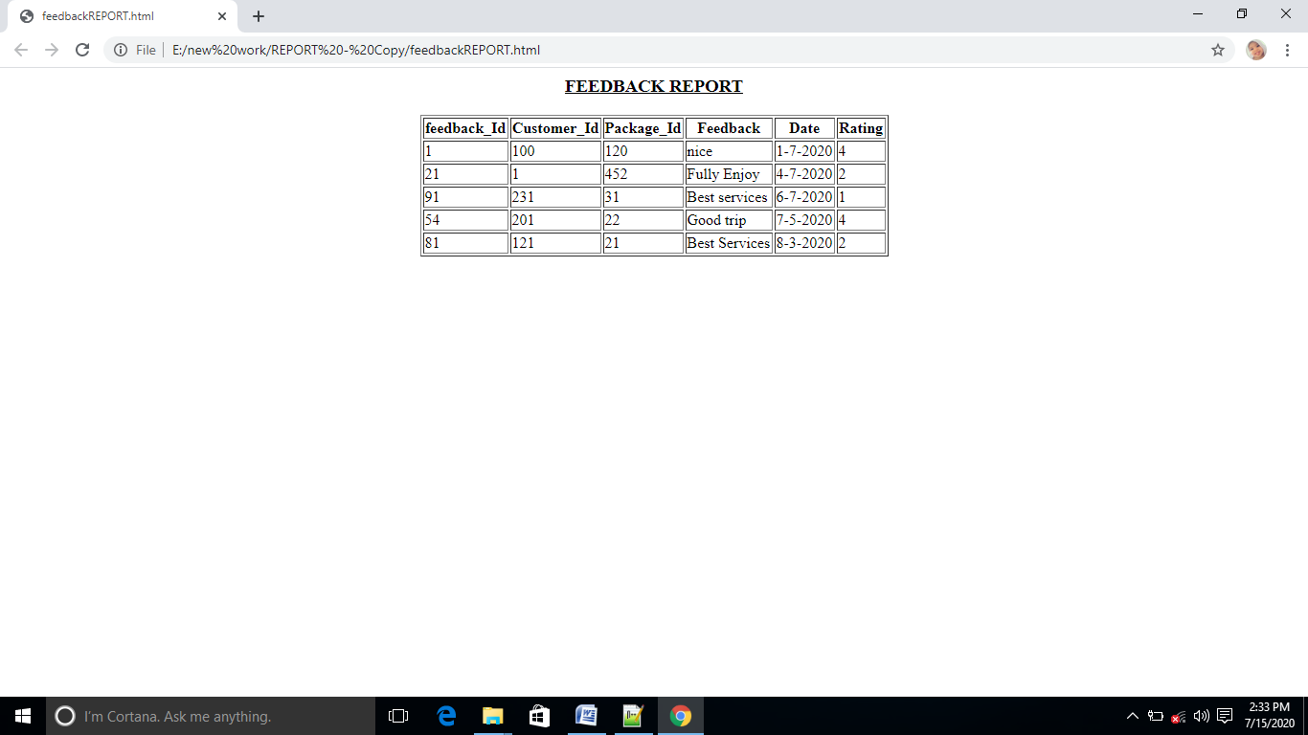
Feedback report

Slide 23
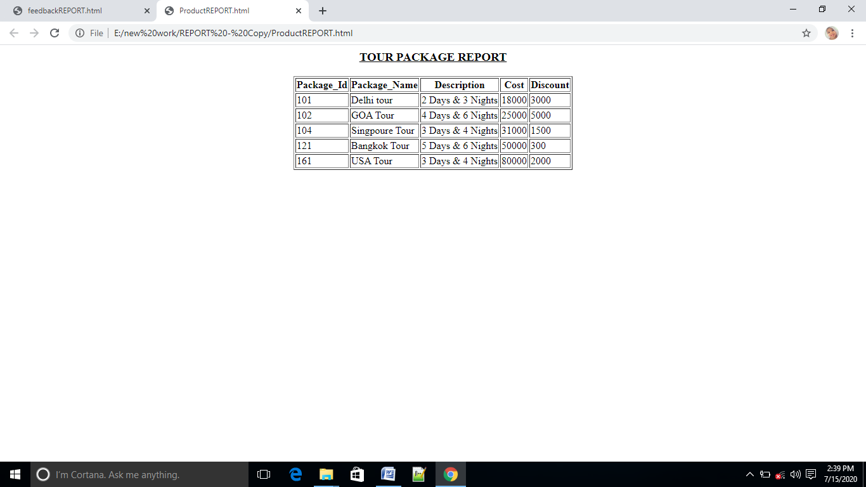
Tour and Package report

Slide 24
TESTING STRATEGIES
System testing
Design
Validation testing
Code
Unit testing
Integration testing
Requirements
System engineering

Slide 25
Bibliography
HTML/DHTML Complete Reference (TMH)
JavaScript Complete Reference (TMH)
JavaScript (O’ Reilly)
JavaScript (Wrox)
JavaScript and DHTML cookbook (O’ Reilly)
Learning Python (O’Reilly)
Learning Python by Mark Lutz
Python Essential Referenced by David Beazley
Programming in Python 3 (Mark Summerfield)
Think Python (O’Reilly)
Python for everybody (CHARLES SEVERANCE)
Python for Beginners 2017

Slide 26
Thank you

